Slide 1
Eureka
Adding a Naming Server

Slide 2
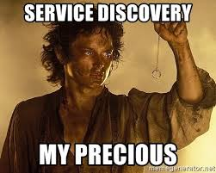

Slide 3
Objective
By the end of this 45 minute session you will be able create a Eureka server and set up your Microservices to register with it.

Slide 4
Needs / Benefits
This is a large portion of the modern Microservices Framework
Disposable services
New services should be able to spawn and be added into the Ribbon rotation without recoding/restarting client microservices

Slide 5
Configure Microservices to Register With Eureka
Environment Setup
Creating Eureka Server

Slide 6
Environment Setup

Slide 7
Git clone https://github.com/Cognizant-FSE/petclinic-eureka-starter
Create Owner, Pet, Vet, Visit databases
Run config-server
Run All 4 Microservices, starting with Owner
Run petclinic-rest-client to populate database
(If continuing from Ribbon deck, continue to use current project. No changes necessary)

Slide 8
Create Eureka Server

Slide 9
What does Eureka Do?
We really don’t want hard coded URLS
Eureka server keeps track of all running instances of all apps
Apps register their address with Eureka when they start
Any other app wanting to access another app finds out where it is by talking to Eureka
Notes:
This makes apps disposable and the overall system scalable.

Slide 10
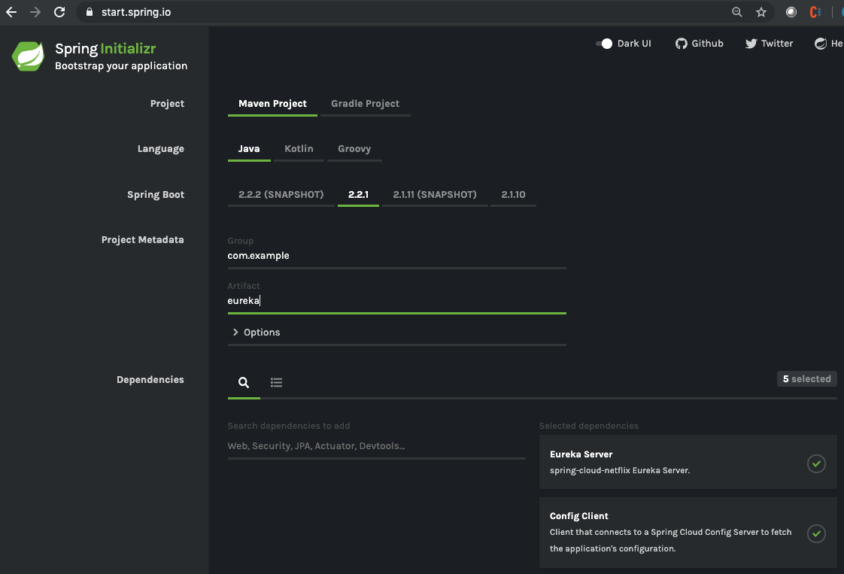
Create new Eureka Server
Eureka Server, Web,
Config Client

Slide 11
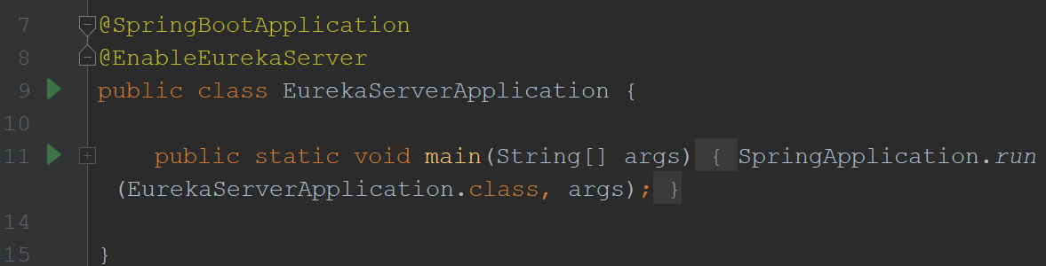
Enable Eureka Server
@EnableEurekaServer

Slide 12
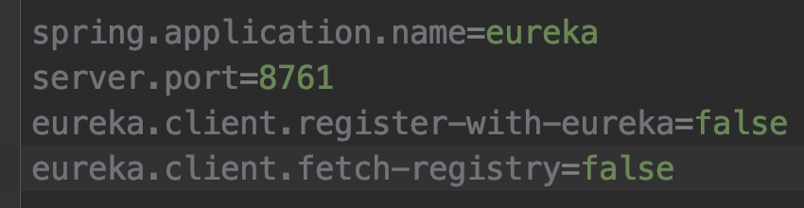
Configure settings in application.properties
This IS Eureka, so it shouldn’t register with itself

Slide 13
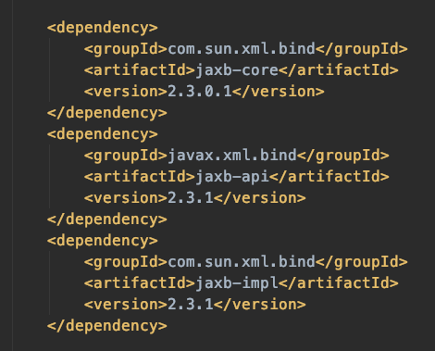
If Running Java 11
May need to add these dependencies which eureka uses

Slide 14
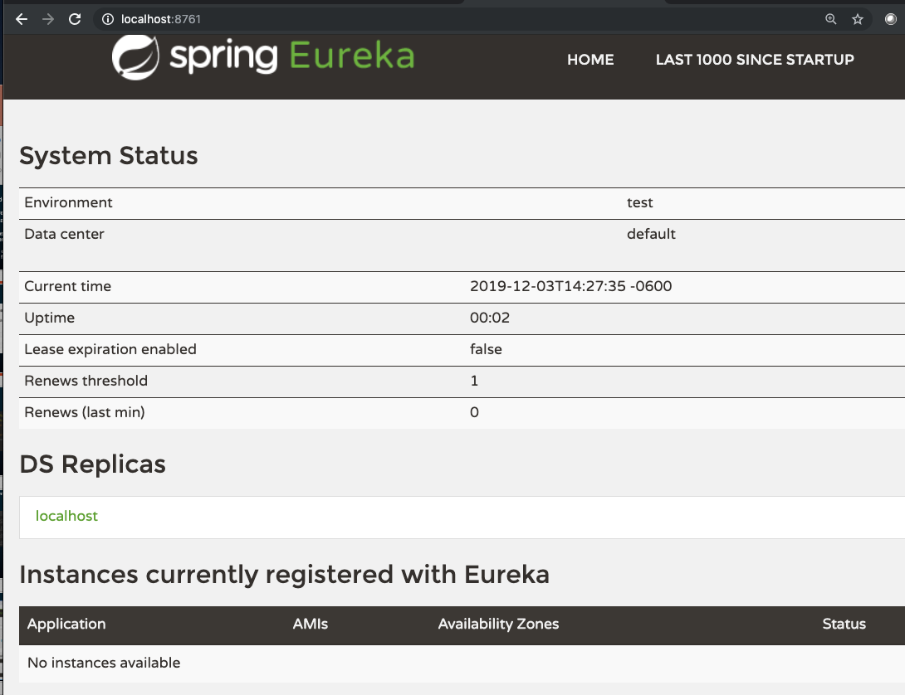
Run the Eureka! Server
No apps registered…YET!

Slide 15
Configure Apps to Register with Eureka Server

Slide 16
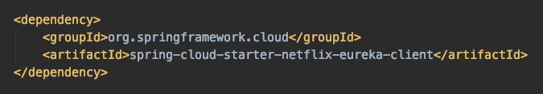
Configure apps to register with Eureka
Maven pom.xml
spring-cloud-starter-netflix-eureka-client

Slide 17
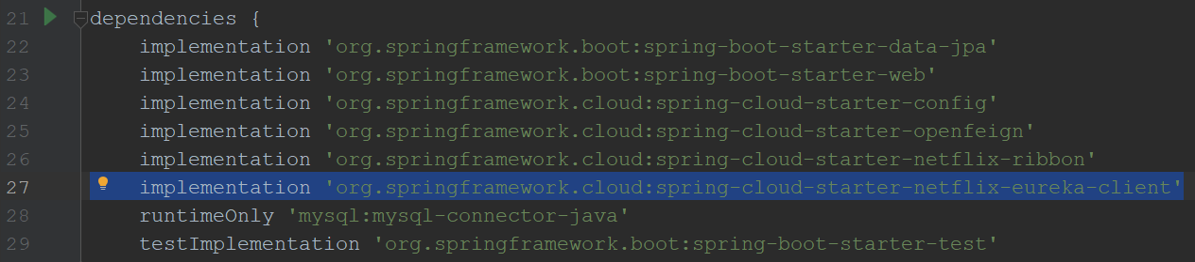
Configure apps to register with Eureka
build.gradle
spring-cloud-starter-netflix-eureka-client

Slide 18
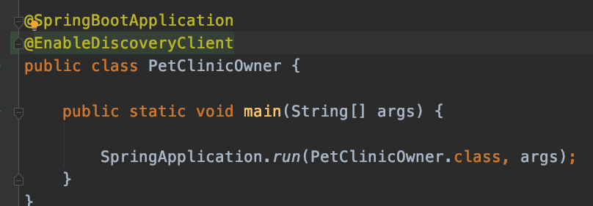
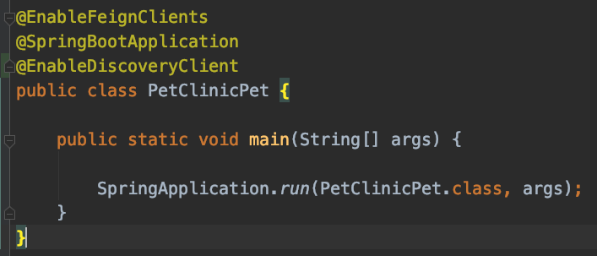
Configure apps to register with Eureka
@EnableDiscoveryClient
Annotation on Application class

Slide 19
Configure apps to register with Eureka
Tell both petclinic-owner and petclinic-pet where to find Eureka and what to call themselves by adding these lines to their application.properties
In order for Feign to continue working, this name must match the Feignclient and RibbonClient name for each respective MS
Delete this line from petclinic-pet application.properties

Slide 20
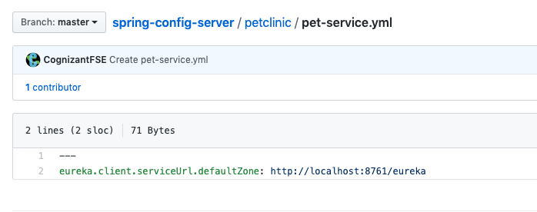
Configure apps to register with Eureka
If you are getting a com.netflix.discovery.shared.transport.TransportException:
Your app may not be picking up the defaultZone from application.properties if you are using a config server
In this case, add the file to your config server repo

Slide 21
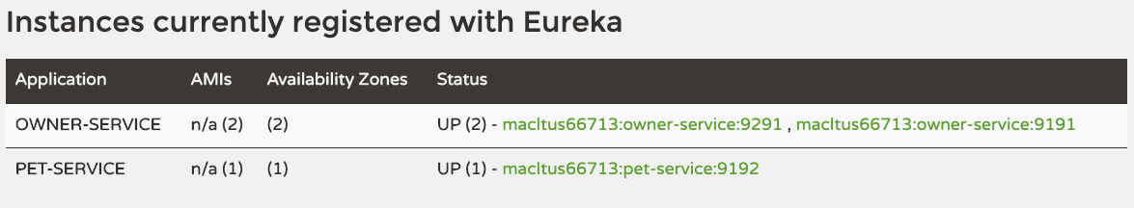
Restart apps
Restart both instances of petclinic-owner and the one instance of petclinic-pet, then refresh Eureka page

Slide 22
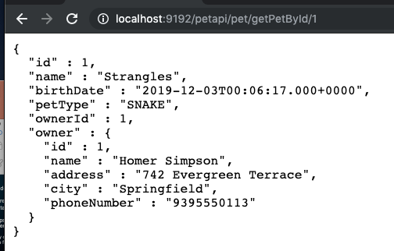
Check Endpoints
Check pet-service endpoint that reaches out to owner-service
It is now getting the url from Eureka!
Notes:
Again, if you want to see the round robin load balancing, include the port in the song bean response

Slide 23
Review
Environment Setup
Creating a Eureka Server
Configure Apps to Register with Eureka

Slide 24
Objective
By the end of this 45 minute session you will be able create a Eureka server and set up your Microservices to register with it.

Slide 25
What are the annotations used both on the Eureka Server side and on the client side?
What are the properties that need to be added, both on the Eureka Server and on the clients?

Slide 27
Jason Monroe
688776

